Slide 1

Information for children with SEND during Covid-19 lockdown
We understand that times are hard for everyone right now but especially for those having to stay home with a SEND child while services are closed. Hackney Ark Resource Centre and Hackney Local Offer co-ordinator have put together this newsletter to share information from local services to help you get through this time. We hope its helpful and stay safe, Sarah and Ella

Slide 2
Supporting evidence letter for children with Autism
We understand that the limits on going out and how we must behave when we are out, may be especially difficult for autistic young people and their families. These are important restrictions that are in place to help make us all safer. They will not last forever and they are not intended to make life really difficult for people who are autistic, those who have learning difficulties or other medical conditions. Government guidance states:
“You can leave your home for medical need. If you (or a person in your care) have a specific health condition that requires you to leave the home to maintain your health - including if that involves travel beyond your local area - then you can do so. This could, for example, include where individuals with learning disabilities or autism require specific exercise in an open space two or three times each day - ideally in line with a care plan agreed with a medical professional.
Even in such cases, in order to reduce the spread of infection and protect those exercising, travel outside of the home should be limited, as close to your local area as possible, and you should remain at least 2 metres apart from anyone who is not a member of your household or a carer at all times.”
To find out how to request a letter please visit:
https://www.hackneylocaloffer.co.uk/kb5/hackney/localoffer/advice.page?id=EzGp60ZySlA

Slide 3
Education
There is a lot of government guidance being produced for parents and this is issued on an ongoing basis. The latest guidance for parents on education covers much of the previous guidance and is a useful reference. It includes information about online lessons available daily for those with digital access, information about how to get access to digital equipment if you do not have it and advice about what to expect from settings and explainers about previous guidance. There are also links to trusted learning resources recommended by special school headteachers and others working in the SEND sectors. “What parents and carers need to know about schools and other education settings during the coronavirus outbreak” is available on the Gov.uk website.
DfE coronavirus helpline: 0800 046 8687
E-mail. DfE.CoronavirusHelpline@education.gov.uk
https://www.gov.uk/government/publications/closure-of-educational-settings-information-for-parents-and-carers?utm_source=1910d343-1533-404f-a176-c51428eff6b6&utm_medium=email&utm_campaign=govuk-notifications&utm_content=immediate
https://www.gov.uk/government/publications/coronavirus-covid-19-send-risk-assessment-guidance
DfE Guidance - Help children with SEND continue their education during coronavirus (COVID-19)

Slide 4
Starline
Starline, a new national helpline for parents offers a free telephone helpline open six days a week. Home learning advice is provided directly from qualified teachers and parenting and education experts.
Phone: 0330 313 9162
Web: www.starline.org.uk

Slide 5
Council for Disabled Children
The Council for Disabled children have been working with the government and national partners to ensure that the concerns and views of parents of disabled children and those with additional educational needs are considered through arrangements made in response to the pandemic. If you have a question about SEND that you cannot get an answer to you can contact them and it may be included in their fortnightly frequently asked questions responses that are published on their website.
https://councilfordisabledchildren.org.uk/help-resources/resources/covid-19-support-and-guidance

Slide 6
Occupational Therapy virtual resources
Phone or video screening calls are offered for all patients who would normally be accepted for new referrals. Interventions are being offered via video call where possible and appropriate and to provide support for the wider community we have recorded our Sensory Workshop for families and can offer this as an ‘Electronic Version’.
Home safety assessments for children who meet this criteria are still on offer via video or phone calls.
Physiotherapy drop-in consultation slots will replace the drop in session for the time being. These begin again on 11th May via phone or video. Service contact number Monday – Friday Sharon (administrator) : 02070147025

Slide 8
Educational Psychologists
Educational Psychology Service are running their parent advice session by phone on Wednesdays from 2-4pm. It’s best to book a slot in advance as with the system for face to face advice.
Contact: 020 8820 5719 on Wednesdays between 2pm – 4.30pm

Slide 9
CAMHS
CAMHS have put together the following documents to update and help families and young people know how to manage their well-being and mental health, with support if needed, during the current government enforced lockdown.
COVID-19 resources for parents-carers CAMHS (information, resources and links)
Short leaflet that helpfully identify sources of support for a those experiencing different levels of difficulty and includes current contact numbers for a range of eventualities.
City Hackney CAMHS COVID Getting Help

Slide 10
Short breaks
The Short Breaks team are still available for queries Monday - Friday 9am - 5pm.
Short Breaks offer - COVID 19 temporary changes and increased flexibility extended - Due to the impact of COVID 19, a number of children and young people are not able to access their usual Short Breaks, either because the carer is unavailable, the Short Breaks provider has had to close/cancel their activities or because you are unable to spend your Individual Budget on your prepaid card. Due to these current exceptional circumstances Short Breaks are offering families some alternative support to the standard Short Break offer and will be allowing families the opportunity to purchase equipment and toys such as outdoor play equipment, books, arts and craft materials, etc. There are restrictions to this offer so please contact the service if you haven’t already received information from them.
Phone 020 8356 6796
e-mail: Short.Breaks@hackney.gov.uk
Web: www.shortbreakshackney.com

Slide 11
SENDIAGS
SENDIAGS, the impartial SEND information, advice and support service, are still working remotely and available for advice by phone. Please contact the service coordinator who will arrange for a team member to call you back.
Phone: 07500 066 513
e-mail: sendiags@learningtrust.co.uk

Slide 12
Prospects Careers Service (part of Shaw Trust)
Prospects have also produced a useful summary of the exam result arrangements for this year:
https://search3.openobjects.com/mediamanager/hackney/fsd/files/gcse_and_a_level_exams_during_pandemic_-_latest_results_guidance_prospects_summary_april_2020.pdf
All settings are working with the government to try to limit any disadvantage to young people that have worked so hard for this important time in their lives.
Prospects Careers Service are still operational by phone and can advise parents and carers and young people themselves about education, training and employment options for next year. The service has a specialist SEND advisor:
Phone: 020 8356 2664 (Prospects office)
Phone: 07769 648 664 ( SEND advisor Bryan Taylor)

Slide 13
Inclusion and Specialist Support Team
Inclusion and Specialist Support Team, Area SENCos, Portage and specialist visual and hearing impairment teams are continuing to work with families know to their services and are happy to provide advice and appropriately signpost to individuals within the teams if appropriate. Resource packs are available on request. Social Stories are available on Hackney’s Local Offer website or by request that explain the situation and help children understand the impact of it and the need for different behaviour at this time.
Contact: Quita - Team Lead Inclusion and Specialist Support 020 8820 7233 (work)

Slide 14
The Early Support Team
The Early Support Team have compiled an activities pack of resources to suit varying levels of need. The team can send the pack to settings and families via email (or hard copies can be sent by mail if more convenient for some families).
These resources range from simple games and activities to play with and without toys, a massage story, online activities for children with autism and much more.
If you would like a copy of the resource pack please e-mail a member of the Early Support Team. Contact details below:
Sasha Lysons Sasha.Lysons@learningtrust.co.uk
Ruth Zialor Ruth.Zialor@learningtrust.co.uk
Livia Slemender Livia.Slemender@learningtrust.co.uk
Dianne Sandler dianne.sandler@learningtrust.co.uk
Joanna Matheson Joanna.Matheson@learningtrust.co.uk
Mamtut Cham Mamtut.Cham@learningtrust.co.uk
Our Area SENCo lead Dianne Sandler also has a Pinterest page with lots of lovely ideas. Access Dianne’s Pintrest page via this link: https://www.pinterest.co.uk/diannesandler/

Slide 15
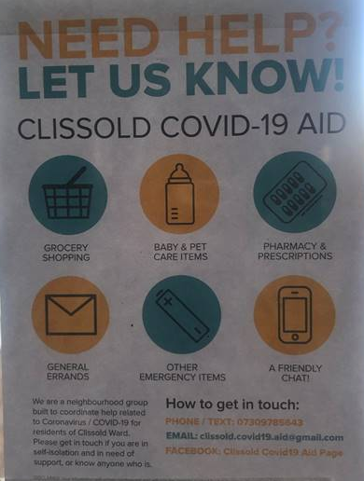
Local mutual aid groups
There a lots of groups popping up around Hackney of volunteers offering practice and emotional support during this time

Slide 16
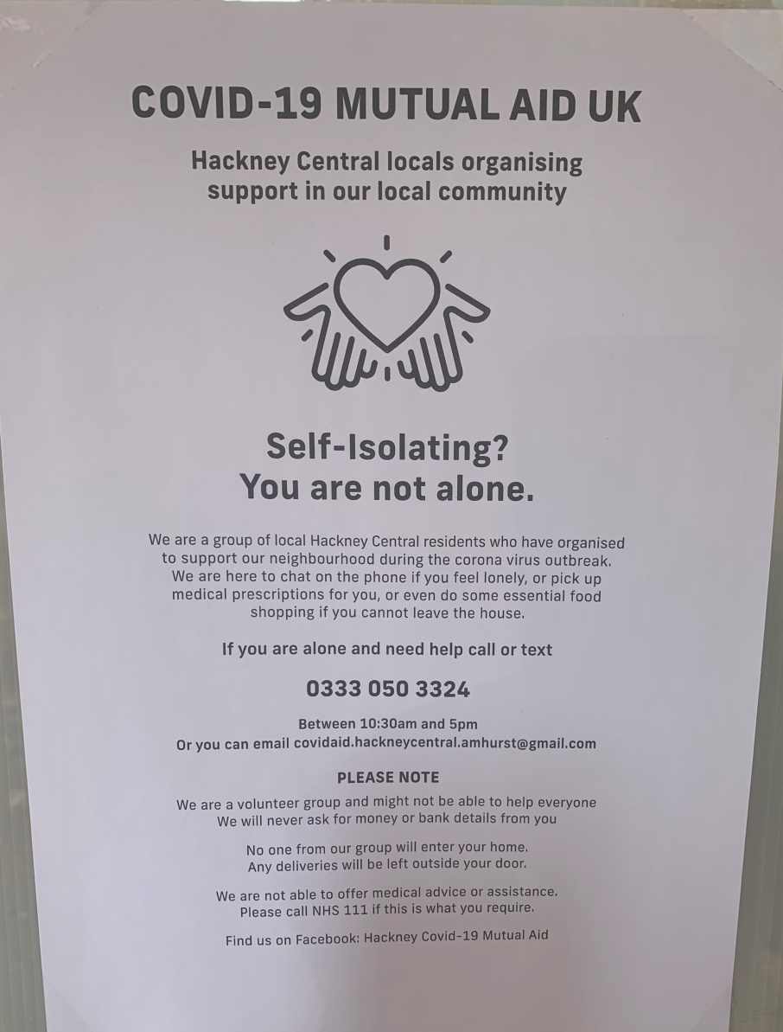

Slide 17
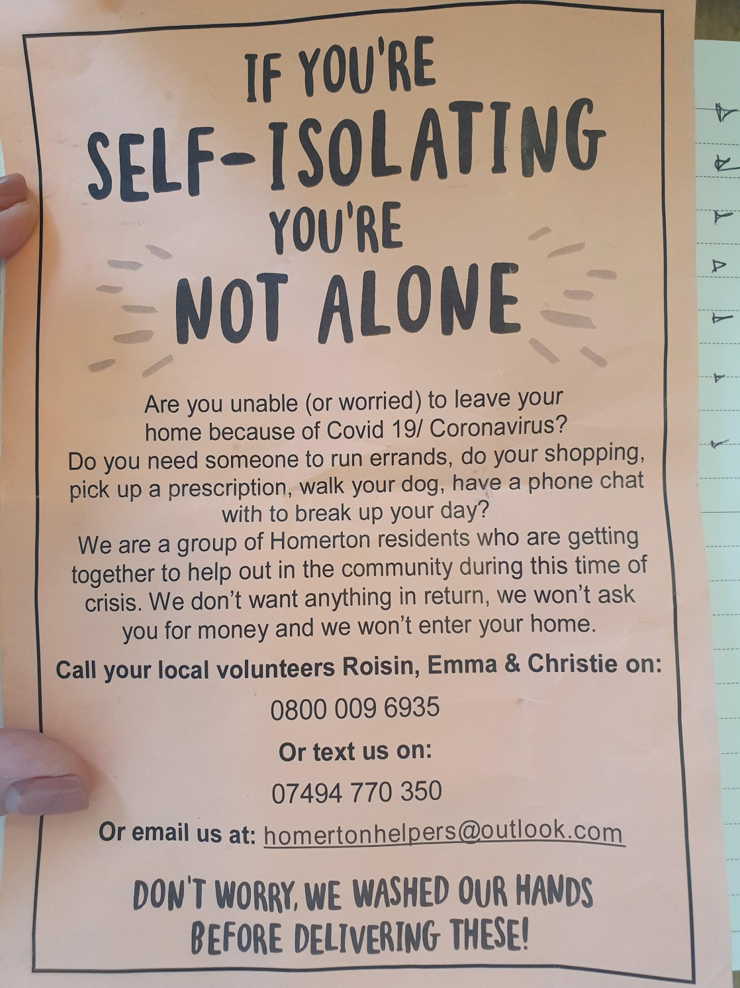
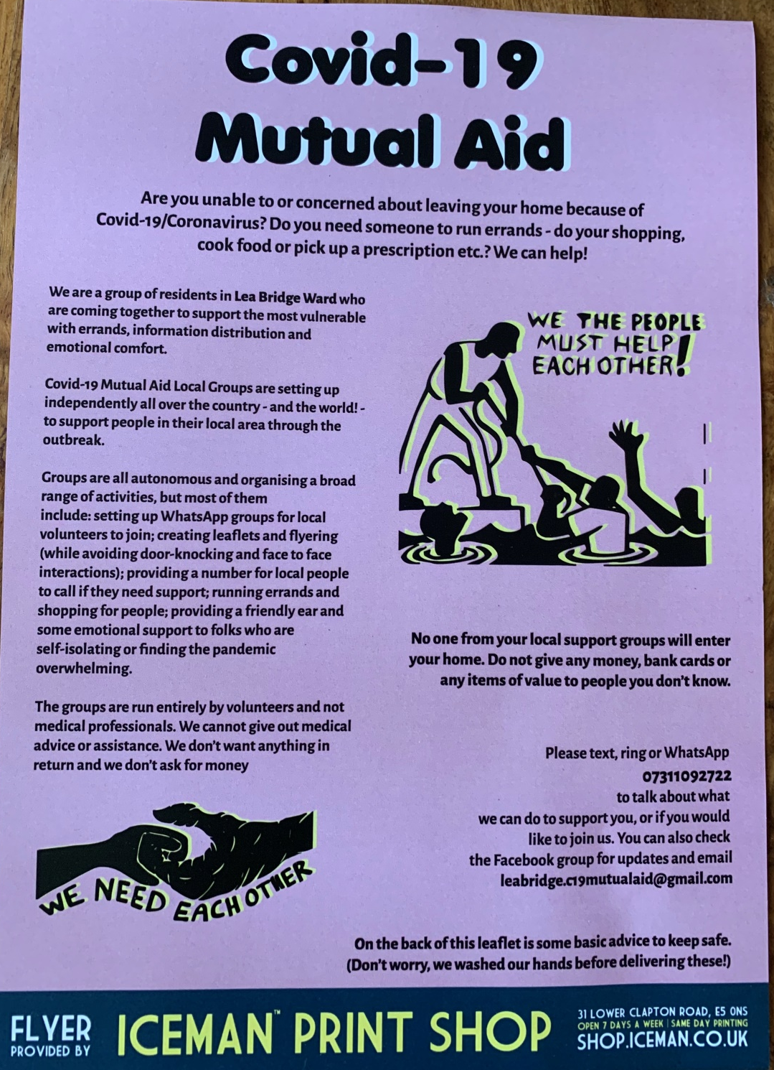

Slide 18
Hackney Learning Trust
A resource bank is available on Hackney Learning Trust’s website with a focus on well-being and learning activities. New resources are added regularly and schools and settings are contacted to make them aware of updates so that they can share them with the parents of children in their settings. Teams at Hackney Learning Trust continue to provide support and advice for settings and are in regular touch with headteachers and SENCos as the situation develops.
www.learningtrust.co.uk/content/mental-health-and-wellbeing-resources

Slide 19
Disabled Children’s Service
Disabled Children's Service social workers are carrying out welfare checks with families and liaising with other services such as schools who may be offering you support. Should you require support around the use of Direct Payments or in relation to queries or concerns about the support being provided by care agencies, please contact your social worker by phone or email.
If this is not possible contact the team on 020 8356 6789

Slide 20
Coping during covid-19 research
The COVID-19 pandemic is an unprecedented global situation which has changed our daily way of life. Research continues to take place on the impacts of Lockdown on mental health. If you would like to share your family’s experiences you can complete the surveys below from Autisica
https://www.lawsonlab.co.uk/covid-19?dm_i=4U0R,C1R0,PHHW4,1CKH1,1
Or Emerging Minds Network
https://cospaceoxford.com/survey

Slide 21
Speech and Language
The Speech and Language team are here to support you during the current situation but many of their usual activities have had to be put on hold.
Talking Walk-in drop-in assessment clinics are not running.
New referrals are being accepted but families will be contacted by telephone in the first instance and only seen face to face if absolutely necessary
Advice and Support will be given by phone and online. There are many resources available on this website which may be useful.
Support with explaining Coronavirus to children and young people can be found on their News page.
Please contact huh-tr.sltinfo@nhs.net with any queries

Slide 22
Sunflower Lanyard scheme
The Sunflower Lanyard acts as a discreet sign that the wearer (or somebody who is with them) has a hidden disability and requires additional assistance. There is no qualifying list to being able to access a lanyard as no one is excluded including people who have yet to be diagnosed and whose daily life is made more challenging by their hidden disability.
You can order you lanyard here

Slide 23
Local offer
Hackney’s SEND Local Offer website has a page listing resources that may be useful during the Coronavirus outbreak with a focus on those with SEND.
It has information, links and resources for children and young people of all ages and abilities. The page also links to the latest information from teams at Hackney Ark and SEND related teams at Hackney Learning Trust. The page is regularly updated and new information or resources
www.hackneylocaloffer.co.uk/team-updates
www.hackneylocaloffer.co.uk/coronavirus-send-resources

